Slide 1
Neighborhood Watch March 2022

Slide 2
2021
Annual Crime Report

Slide 3
Part 1 Crimes
Type of crime | 2020 | 2021
homicide | 1 | 0
rape | 6 | 12
aggravated assault | 60 | 44
robbery | 26 | 23
burglary | 105 | 88
larceny | 446 | 471
auto theft | 147 | 173
arson | 2 | 2
Total | 793 | 813

Slide 4
City Comparison

Slide 5
Part I Crime
Notes:
915

Slide 6
Part I Crime Comparison
Per 10,000 Residents

Slide 7
Part I Crime Comparison

Slide 8
Part I Crime

Slide 9
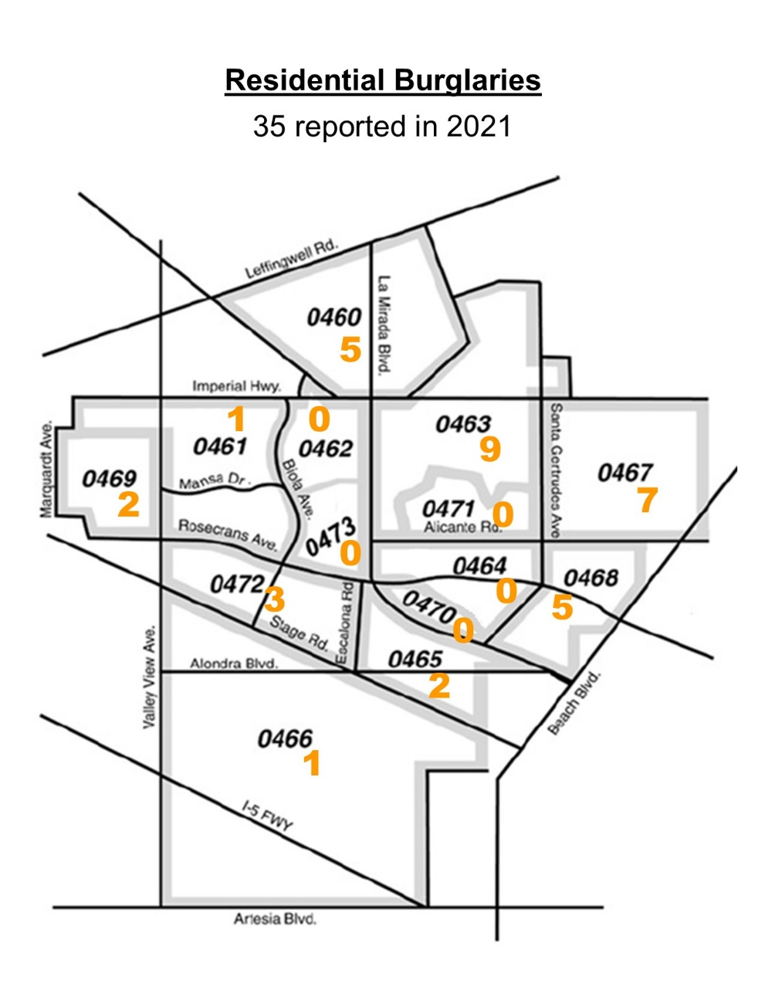
Residential Burglaries by Reporting District (RD)

Slide 10
Part I Crime

Slide 11
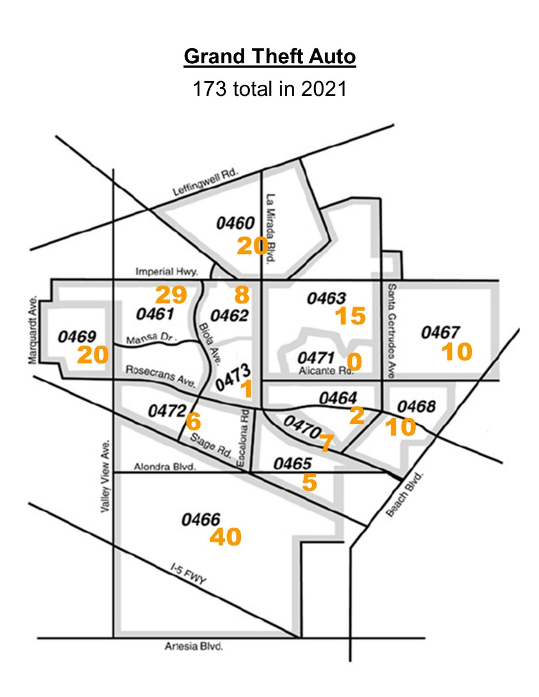
by Reporting District (RD)
Grand Theft Auto

Slide 12
Part II Crime
Notes:
12

Slide 13
Avg. Response Times
2017-2021
Notes:
13

Slide 14
2021 Accomplishments
La Mirada’s Part 1 Crimes Remain the Lowest in the Region
Violent Crimes Remain Low
Burglaries, Robberies and Assaults Decreased from 2020
SAO Team Conducted Investigations and Made Key Arrests
21 Neighborhood Watch Meetings were Held
Business Watch Outreach Efforts Grew
Public Safety Officers Prepared 39 Traffic Collision Reports and 207 Non-Workable Crime Reports
Notes:
14

Slide 15
La Mirada Standards for 2022
Maintain a Low Crime Rate (200 crimes/10,000 residents)
Reduce Property Crimes
Enhance Visibility in the Community
Keep Response Times Low
SAO Team will Focus on Preventing and Suppressing Criminal Activity
Dedicated to Enforcing the Laws
Use Social Media to Educate Residents and Businesses
Notes:
15

Slide 16
Neighborhood Watch
Upcoming meetings
On Zoom
Wednesday, June 15 at 6 p.m.
Wednesday, September 21 at 10 a.m.
Wednesday, December 8 at 6 p.m.
In person
Neff Barn Thursday, April 14 at 6:30 p.m.
Notes:
16

Slide 17
Propositions and Bills affecting crime
Assembly Bill 109
Proposition 47
Proposition 57
Public Safety Realignment
Safe Neighborhoods & Schools Act
Public Safety & Rehabilitation Act
Transferred responsibility for housing and supervising some convicted felons from State prison to local jail facilities Resulted in an estimated 45,000 felons being transferred
Reduced sentences and downgraded penalties a number of crimes from felonies to misdemeanors, including drug possession and thefts under $950
Allowed the State to provide early release for up to 30,000 convicted felons in State prison
The overall effect of these is more criminals on the street…

Slide 18
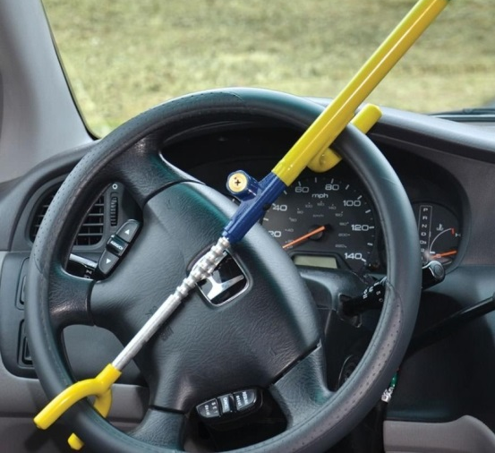
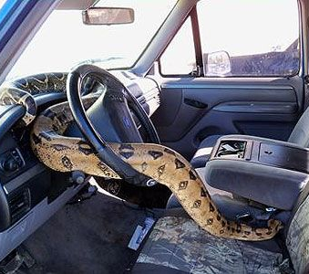
Crime Trends
Grand theft automobiles and vehicle burglaries increased during the pandemic. Residential Burglaries are down. To make yourself less of a target follow these tips.
Park your vehicles in the garage or driveway when possible.
Lock your vehicles and use anti-theft devices on older vehicles.
Do not leave any valuables or back packs in the vehicle.
Park in a well-lit area.
Notes:
18

Slide 19
Most Crimes are crimes of opportunity.
Make yourself less of a target.
Report suspicious individuals or vehicles in your area
Install good lighting with motion sensors around the outside of your house
Install additional security systems like the 'Ring' doorbell and an audible alarm
Have neighbors pick up packages or send to a facility to be picked up, or have delivered to work if you can
Notes:
19

Slide 20
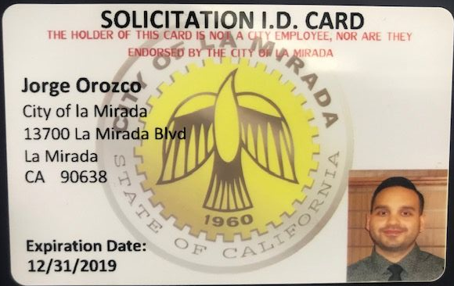
Report unauthorized solicitors. Each solicitor must have a City solicitor’s permit and a valid picture ID while soliciting.
Draw the curtains and blinds at night
Ask service technicians or care providers you don't know for ID before you open the door
Keep a list of serial numbers for valuable items
Notes:
20

Slide 21
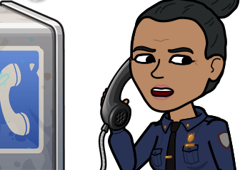
Remember if you or a neighbor see a crime in progress or notice suspicious activity, observe and report from a place of safety as soon as possible. Helpful information includes:
Location, Location, Location
Direction of travel
Vehicle information: type, license number, color, year, make, model, unusual characteristics (e.g., dents, bumper stickers), number of persons, etc.
Suspect information: gender, age, height, weight, hair color, hair length and style, eye color, facial hair, clothing type and color, other characteristics (e.g., tattoos, missing teeth, scars, glasses)
Notes:
21

Slide 22
Get Connected
Input
Input the La Mirada Community Sheriff’s Station # in your phone 562-902-2960
Like
Like the La Mirada Public Safety Facebook Page
Download
Download “Mylamirada” app to report items like graffiti or worn-out signs, and blighted houses.
Follow
Follow us on Twitter @LaMiradaPS
Join
Join E-Watch and Nextdoor
Notes:
22

Slide 23
Join La Mirada E-Watch by visiting www.cityoflamirada.org and click on the “La Mirada E-Watch” link
You will receive information weekly via email
Weekly crime summaries
Crime map
Crime Prevention tips
“Be on the Look Out” alerts
Notes:
23

Slide 24
Neighborhood Watch
Studies show that neighborhoods will experience an average of a 16% crime reduction under the protection of a Neighborhood Watch program. Some other benefits of Neighborhood Watch program include:
An increased sense of responsibility and control
Increased sense of personal security
Greater unity within neighborhoods
Improved relations with law enforcement
Improved quality of life
Notes:
24

